Slide 1

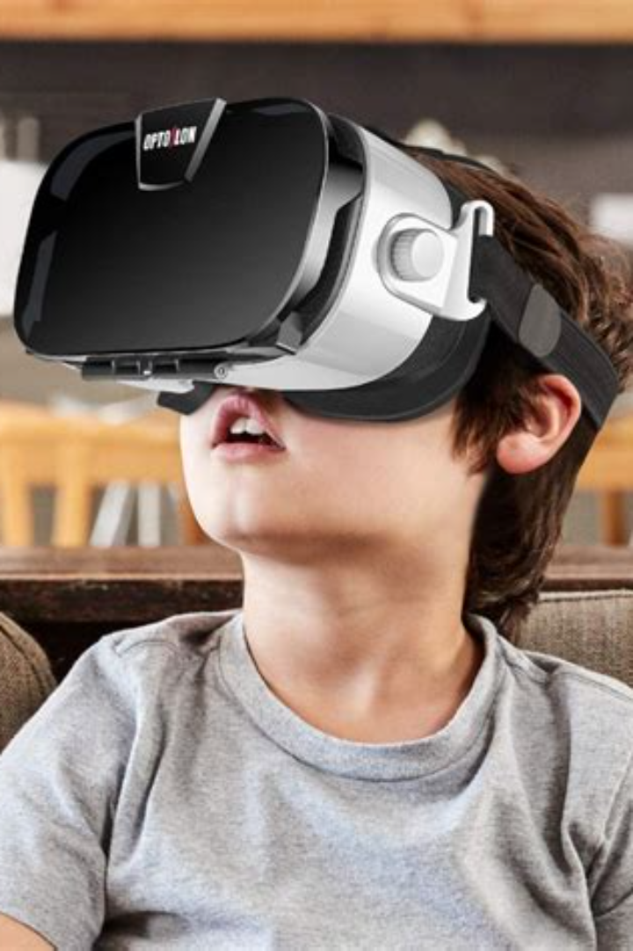
Virtual Reality
Discover the world of virtual reality - a computer-generated simulation that immerses users in a virtual environment through headsets and interactive experiences. Journey into a new dimension!
By Nandini

Slide 2

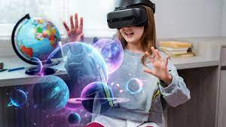
Introduction
Virtual reality (VR) is a powerful technology that transports users to simulated worlds, enhancing their perception and interaction with the digital realm. Explore the definition and history of VR.

Slide 3

Types of Virtual Reality
Immersive VR
Non-immersive VR
Mixed Reality
The condition in which the user loose awareness of the fact that they are actually in an artificial world.
It refers to a virtual experience through a computer where you can control some characters or activities within the software but the environment is not directly interacting with you.
It is an emergent technology that blends virtual reality and augmented reality.

Slide 4
Applications of Virtual Reality
1
Gaming and Entertainment
2
Education and Training
Immerse yourself in breathtaking adventures, realistic simulations, and interactive storytelling.
Enhance learning through immersive experiences, enabling students to explore historical events, scientific concepts, and more.
3
Healthcare and Therapy
4
Architecture and Design
Provide innovative treatments, pain management, and mental health support through VR interventions.
Create virtual prototypes, walkthroughs, and visualizations to aid in the planning and design process.

Slide 5
Benefits of Virtual Reality
Cost-effectiveness and Accessibility
Enhanced User Experience
Improved Learning and Retention
Immerse users in extraordinary virtual worlds, allowing them to engage with digital content like never before.
Boost knowledge retention and understanding by providing interactive and memorable learning experiences.
Enable affordable access to virtual experiences, breaking barriers and reaching a wider audience.

Slide 6

Challenges and Limitations of Virtual Reality
2
High Costs of Setup and Maintenance
3
Social Implications
1
Motion Sickness and Discomfort
it creates addiction, and the blurring boundaries between virtual and real-world experiences.
Some users may experience nausea or discomfort due to the disconnection between visual and physical movements.
Investing in VR hardware, software, and maintenance can be expensive, making it less accessible to some individuals and organizations.

Slide 7

Future of Virtual Reality
1
Advancements in Technology
Continual progress in hardware, software, and tracking systems will drive the evolution of virtual reality, offering more realistic and immersive experiences.
2
Potential Impact on Various Industries
VR has the potential to revolutionize industries like education, healthcare, tourism, and remote work, transforming the way we live, work, and connect.
3
Conclusion
Virtual reality opens endless possibilities, bridging the gap between imagination and reality. Embrace this technological marvel and embark on extraordinary journeys.

Slide 8


Augmented Reality
Welcome to the exciting world of augmented reality! Discover how this technology enhances our perception of reality by overlaying digital information onto the physical world.
By Shweta

Slide 9
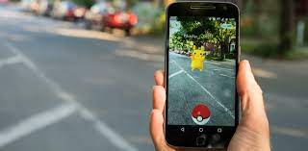
Definition and Explanation
Augmented reality (AR) refers to the integration of digital elements, such as images, videos, or 3D models, into the real world in real-time. It enhances our sensory experience and blurs the line between the physical and digital realms.

Slide 10
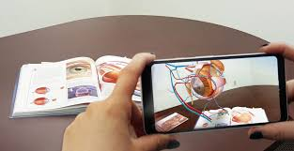
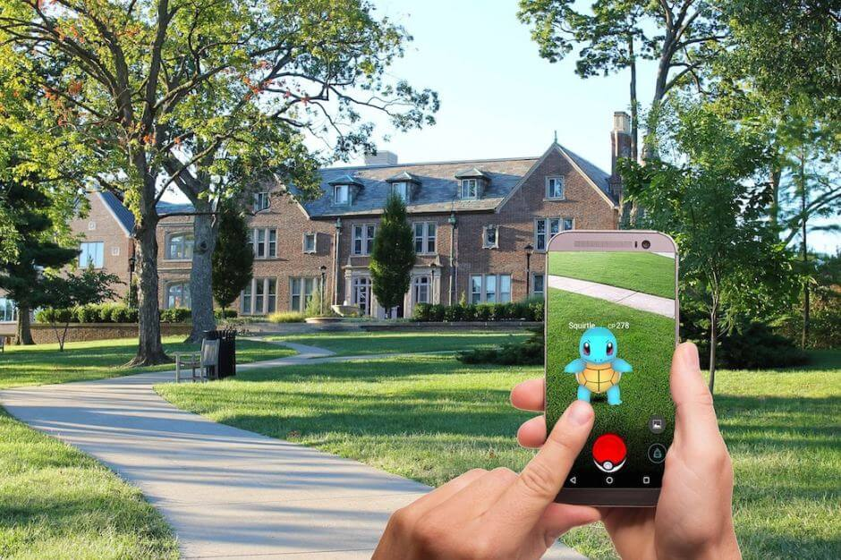
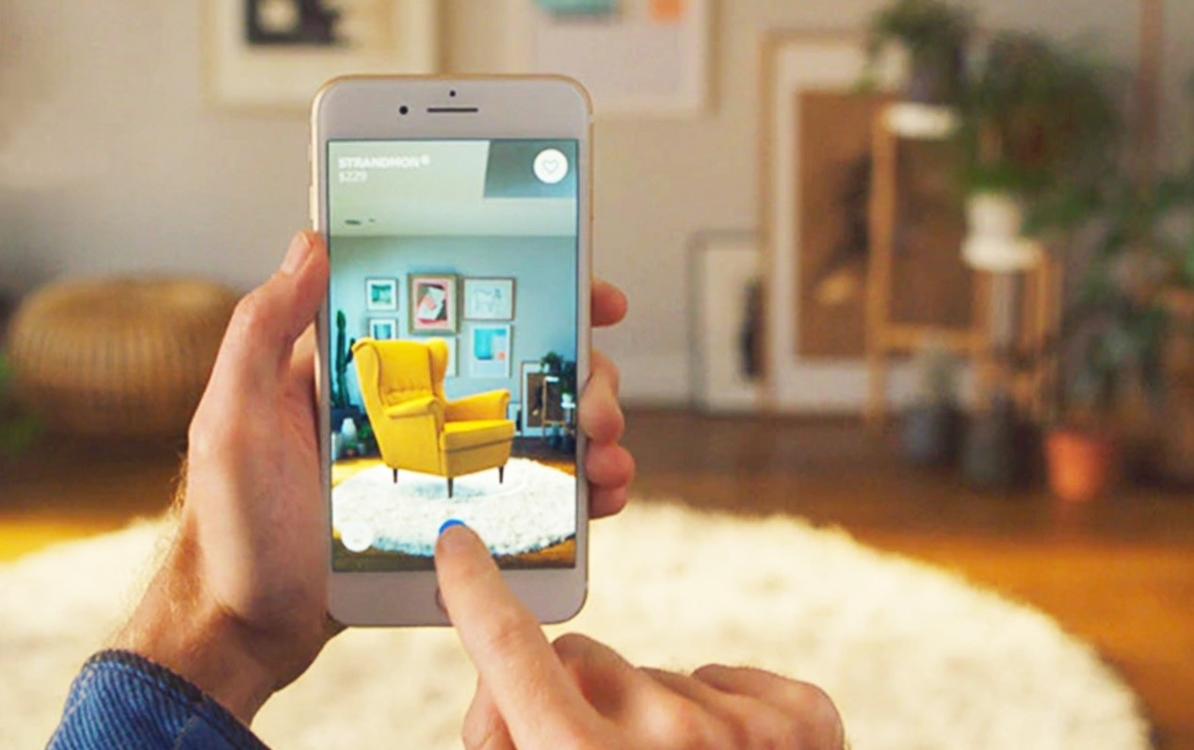

Applications and Uses
Education 🎓
Entertainment 🎮
AR revolutionizes the classroom experience, making learning more interactive and engaging. Students can virtually explore historical sites or dissect virtual organisms with AR simulations.
AR games like Pokemon Go and Minecraft Earth bring digital objects and characters into our physical surroundings, transforming the way we interact with our environment.
Retail 🛍️
Healthcare 🏥
AR allows customers to visualize products in their own spaces before making a purchase. Virtual try-on for clothing or previewing furniture placement are just a few examples.
AR assists in surgery planning, medical training, and patient education. Doctors can overlay vital information onto the patient's body, facilitating a more precise and efficient diagnosis.

Slide 11

Advantages and Benefits
1
Enhanced User Experience 🌟
2
Improved Training and Education 💡
3
Increased Efficiency and Productivity ⚙️
AR provides immersive and interactive experiences, adding depth and excitement to various industries, resulting in increased customer engagement and satisfaction.
Through hands-on simulations and interactive content, AR improves learning outcomes and retention, enabling more effective training and education methods.
AR technology can streamline workflows, reduce errors, and provide real-time guidance, enabling workers to perform tasks more efficiently and accurately.

Slide 12

Challenges and Limitations
1
Technical Limitations 🛠️
2
User Acceptance 😕
3
High development cost
As AR becomes more prevalent, privacy concerns and potential social isolation issues may hinder widespread acceptance.
Creating AR applications can be expensive due to specialized skills and expensive hardware requirement.
Current AR systems often require powerful hardware and stable internet connections, limiting accessibility and adoption.

Slide 13

Current Trends and Future
1
Enhanced Wearables
Expect to see advanced AR glasses and contact lenses that seamlessly integrate digital content with our vision.
AR in Social Media
2
Platforms like Instagram and Snapchat continue to incorporate AR filters and effects, shaping the way we express ourselves online.
Industrial Applications
3
AR is revolutionizing industries such as manufacturing, logistics, and maintenance through hands-free data visualization and remote assistance.

Slide 14
Questions🤔

Slide 15
Thank You👍

